Slide 1

Department of Computer Science, CUI Lahore Campus
Formal Methods in Software Engineering
By
Farooq Ahmad

Slide 2
Petri nets: Introduction
Structure

Slide 3
Limitation of Z and VDM
the specification notation Z (and VDM) was designed to specify data and the evolution of data.
It does not provide any means to explicitly specify behavior.
In Z (and in VDM) , we can only specify sets of operations, but we cannot express that we want to occur the operations in a certain order.

Slide 4
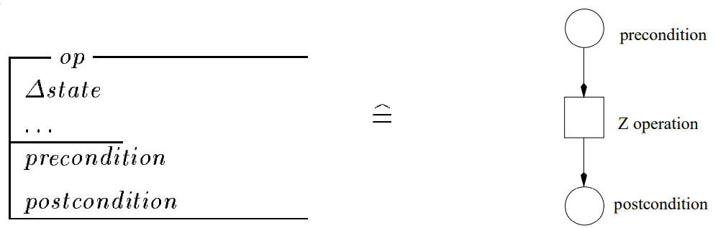
From Z to Petri net

Slide 5
Petri nets
The classical Petri net was invented by Carl Adam Petri in 1962.
A lot of research has been conducted (>10,000 publications).
Until 1985 it was mainly used by theoreticians.
Since the 80-ties the practical use is increasing because of the introduction of high-level Petri nets and the availability of many tools.
High-level Petri nets are Petri nets extended with
color (for the modeling of attributes)
time (for performance analysis)
hierarchy (for the structuring of models)

Slide 6
The Classic Petri net model
A Petri net is a network composed of places ( ) and transitions ( ).
t2
t1
p2
p1
t3
p4
p3
Connections, called arcs, are directed and between a place and a transition.
Tokens ( ) are the dynamic objects.
The state of a Petri net, called marking, is determined by the distribution of tokens over the places.
Initial marking (1, 2, 0, 0)

Slide 7
p1
t1
p4
p2
p3
Transition t1 has three input places (p1, p2 and p3) and two output places (p3 and p4).
Place p3 is both an input and an output place of t1.

Slide 8
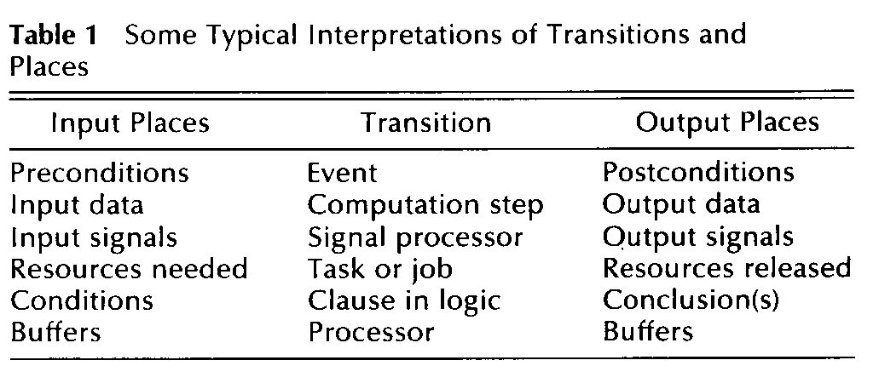
Places and Transitions
Transitions are the active components, while places and tokens are passive.

Slide 9
Enabling condition
A transition is enabled if each of the input places contains tokens.
t1
t2
Transition t1 is not enabled, transition t2 is enabled.

Slide 10
Firing of transition
An enabled transition may fire.
Firing corresponds to consuming tokens from the input places and producing tokens for the output places.
t2
t2
Firing is atomic.

Slide 11
Example

Slide 12
Petri Net Structures
sequence of events/actions:
concurrent execution:
t1
t2
t3
t2
t3
t1
t4
t5

Slide 13
Non-determinism
t1
Two transitions fight for the same token: conflict.
Even if there are two tokens, there is still a conflict.
t2
Synchronization
t1

Slide 14
Modelling
States of a process or a system are modelled by tokens in places and state transitions leading from one state to another are modelled by transitions.
Tokens represent objects (humans, goods, machines, resource), information, conditions or states of objects.
Places represent buffers, channels, geographical locations, conditions or states.
Transitions represent events, transformations or transportations.

Slide 15
Example: Traffic light
red
yr
rg
yellow
gy
green

Slide 16
Two traffic lights
red1
red2
yr1
yr2
rg1
yellow1
yellow2
rg2
gy1
gy2
green1
green2

Slide 17
Two safe traffic lights
red1
red2
safe
yr1
yr2
rg1
yellow1
yellow2
rg2
gy1
gy2
green1
green2

Slide 18
Two safe and fair traffic lights
red1
red2
safe2
yr1
yr2
rg1
yellow1
yellow2
rg2
gy1
gy2
safe1
green1
green2

Slide 19
red1
red2
safe2
yr1
yr2
rg1
yellow1
yellow2
rg2
gy1
gy2
safe1
green1
green2

Slide 20
red1
red2
safe2
yr1
yr2
rg1
yellow1
yellow2
rg2
gy1
gy2
safe1
green1
green2

Slide 21
red1
red2
safe2
yr1
yr2
rg1
yellow1
yellow2
rg2
gy1
gy2
safe1
green1
green2

Slide 22
red1
red2
safe2
yr1
yr2
rg1
yellow1
yellow2
rg2
gy1
gy2
safe1
green1
green2

Slide 23
red1
red2
safe2
yr1
yr2
rg1
yellow1
yellow2
rg2
gy1
gy2
safe1
green1
green2

Slide 24
red1
red2
safe2
yr1
yr2
rg1
yellow1
yellow2
rg2
gy1
gy2
safe1
green1
green2

Slide 25
Reachability
Reachable marking A marking is said to be reachable if it can be reached by firing a sequence of enabled transitions form the initial marking of a Petri net.
Petri net token game tool:
https://my-petri-net.patrickrompf.de

Slide 26
Reference and reading material
Chapter # 8: of the book “Formal Methods in Computer Science” by Jia sun Wang

